Slide 1
I211 – Information Infrastructure II
Lecture 10

Slide 2
Connecting to CGI
For URLs, HTTP supports A-Z, a-z, 0-9, /, : and .
It also supports many special characters, like ~ and space
However, these may need to be converted into special character encodings for all http sites, browsers, etc. to understand them
Just like \n and \t are understood to be special characters for printing
For URLs, this is called quoting.

Slide 3
Connecting to CGI
Special characters are converted into hexadecimal codes (base 16 numbers)
A single character is represented by a single code, even if that code uses multiple numbers or letters. Ex: C8 is hex for 200 (base 10).
To get the integer code for a character:
ord(“A”) -> 65 #ord stands for ‘ordinal’
ord(“~”) -> 126 #these numbers are base 10

Slide 4
Connecting to CGI
So, to quote a URL, we:
Identify a special character char = “~”
Get its integer code c = ord(char)
Convert the code to hex
h = hex(c)[2:] -> “7e” #we remove the “0x”
h = "%X" % c -> “7E” #second method
Need to add a “%” in front of hex codes
Why quoting?
To form a standard URL that should always work
http://www.blooberry.com/indexdot/html/topics/urlencoding.htm
Quoting can sometimes cause problems, especially with CGI, so be careful!!

Slide 5
URL Quote (Group Work)
Write a function called quoteURL that takes one parameter, url, and returns that url with all special characters quoted. A special character is anything other than A-Z, a-z, 0-9, /, : and . (Don’t use the built-in function)
>>>
What URL should we quote: http://php.indiana.edu/~johfdunc/I211/I211Test.html
http://php.indiana.edu/%7Ejohfdunc/I211/I211Test.html
>>>
What URL should we quote: http://quote.yahoo.com/d/quotes.csv?s=GOOG& f=sl1d1t1c1ohgvj1pp2owern&e=.csv
http://quote.yahoo.com/d/quotes.csv%3Fs%3DGOOG%26%Bf%3Dsl1d1t1c1ohgvj1pp2owern%26e%3D.csv

Slide 6
URL Quote (Solution 1)
import urllib
def quoteURL(url):
newURL = ""
for letter in url:
num = ord(letter)
if (num >= 65 and num <= 90) or (num >= 97 and num <= 122) \
or (num >= 46 and num <= 58):
newURL += letter
else:
hex = "%X" % num
newURL += "%" + hex
return newURL
print quoteURL(raw_input("What URL should we quote: "))

Slide 7
URL Quote (Solution 2)
import urllib
def quoteURL(url):
newURL = ""
for letter in url:
if letter.isalnum() or letter in "/:.": #alphanumeric
newURL += letter
else:
num = ord(letter)
hex = "%X" % num
newURL += "%" + hex
return newURL
print quoteURL(raw_input("What URL should we quote: "))

Slide 8
Connecting to CGI
Python actually has a built-in method for this!
import urllib
urllib.quote("http://php.indiana.edu/~johfdunc/I211/I211Test.html")
->
'http%3A//php.indiana.edu/%7Ejohfdunc/I211/I211Test.html'
This also quotes : which can give bad results.

Slide 9
Connecting to CGI
If you want your original url back (to display it, for example), use the unquote method
import urllib
urllib.unquote('http%3A//php.indiana.edu/%7Ejohfdunc/I211/I211Test.html')
->
'http://php.indiana.edu/~johfdunc/I211/I211Test.html'

Slide 10
Wiki Browsing pt 1 (Group Work)
Let’s use our link-finder code (Lecture 8, last slide) to simulate browsing random links on Wikipedia:
>>>
Where would you like to start? http://en.wikipedia.org/wiki/Australian_Army_Intelligence_Corps
How many jumps? 7
Jumping from : http://en.wikipedia.org/wiki/Australian_Army_Intelligence_Corps
To : http://en.wikipedia.org/wiki/Lieutenant_Colonel
Jumping from : http://en.wikipedia.org/wiki/Lieutenant_Colonel
To : http://en.wikipedia.org/wiki/Cardinal_(Catholicism)
Jumping from : http://en.wikipedia.org/wiki/Cardinal_(Catholicism)
To : http://en.wikipedia.org/wiki/Maronite
Jumping from : http://en.wikipedia.org/wiki/Maronite
To : http://en.wikipedia.org/wiki/Sephardi_Jews
Jumping from : http://en.wikipedia.org/wiki/Sephardi_Jews
To : http://en.wikipedia.org/wiki/Jewish_cuisine
Jumping from : http://en.wikipedia.org/wiki/Jewish_cuisine
To : http://en.wikipedia.org/wiki/Bar_and_Bat_Mitzvah
Jumping from : http://en.wikipedia.org/wiki/Bar_and_Bat_Mitzvah
To : http://en.wikipedia.org/wiki/Halakha
HINTS:
- Instead of looking for HREF and HTTP, look for HREF and WIKI
- Build a list of the links on the page, then use random.choice() to pick one.
- Wikipedia uses relative links – you’ll have to make full URLs out of them!

Slide 11
Wiki Browsing pt 1 (Solution)
import urllib, random
def link_list(page):
web_page = urllib.urlopen(page)
lines = web_page.readlines()
web_page.close()
links = []
for line in lines:
parts = line.decode("utf-8").replace(">", "<").split("<")
for item in parts:
if "href" in item and "wiki" in item and ".org" not in item:
item = item[item.index("href="):]
link_parts = item.split("\"")
if len(link_parts) > 1:
links.append(link_parts[1])
return links
#main
pages = [raw_input("Where would you like to start? ")]
current = pages[0]
jumps = int(raw_input("How many jumps? "))
for i in range(jumps):
print "Jumping from :", current
pages = link_list(current)
current = "http://en.wikipedia.org" + random.choice(pages)
print "To :", current, "\n"

Slide 12
Webbrowser Module
The Python Standard Library includes a module for working with browsers: webbrowser
https://docs.python.org/2/library/webbrowser.html
Opening a webpage in the user’s default browser is this simple:
import webbrowser
webbrowser.open("http://www.soic.indiana.edu/")
We can also specify the use of tabs:
webbrowser.open_new_tab("http://www.soic.indiana.edu/")

Slide 13
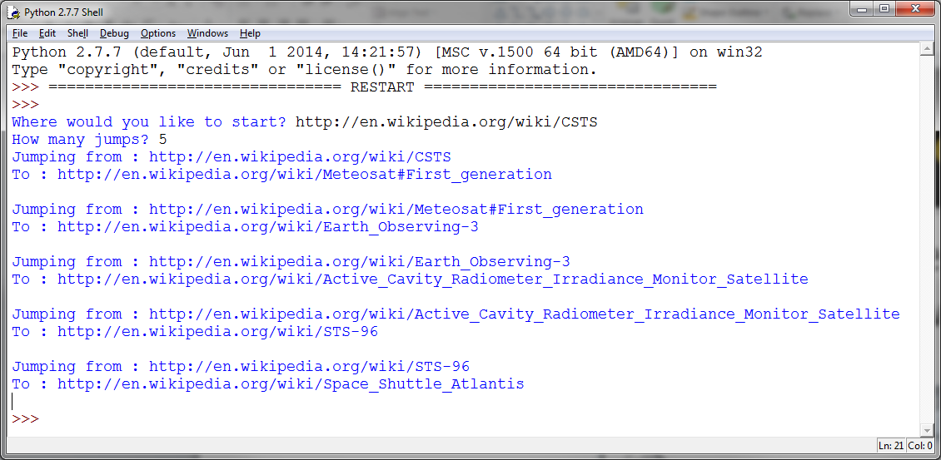
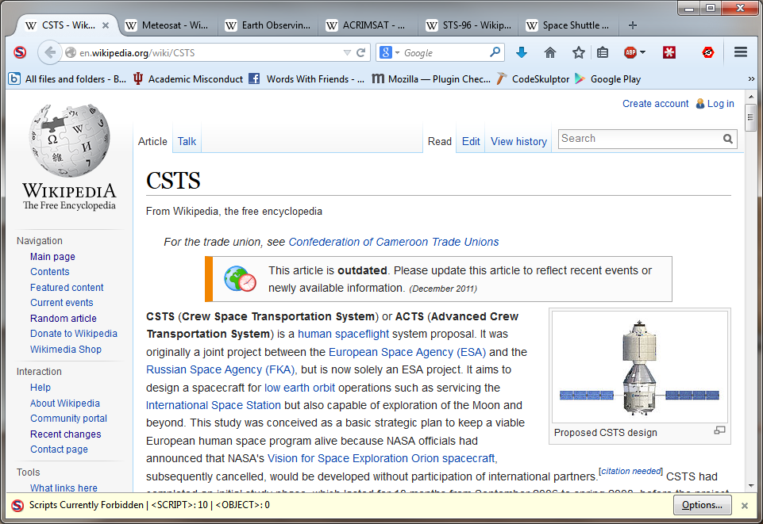
Wiki Browsing pt 2 (Group Work)
Use the webbrowser module to open each page along the way in the browser.

Slide 14
Wiki Browsing pt 2 (Solution)
#main
pages = [raw_input("Where would you like to start? ")]
current = pages[0]
jumps = int(raw_input("How many jumps? "))
webbrowser.open(current)
for i in range(jumps):
print "Jumping from :", current
pages = link_list(current)
current = "http://en.wikipedia.org" + random.choice(pages)
print "To :", current, "\n"
webbrowser.open_new_tab(current)
import urllib, random, webbrowser
def link_list(page):
web_page = urllib.urlopen(page)
lines = web_page.readlines()
web_page.close()
links = []
for line in lines:
parts = line.decode("utf-8").replace(">", "<").split("<")
for item in parts:
if "href" in item and "wiki" in item and ".org" not in item:
item = item[item.index("href="):]
link_parts = item.split("\"")
if len(link_parts) > 1:
links.append(link_parts[1])
return links

Slide 15
Retrieving Media
Downloading a file is as simple as specifying the URL to the file, and the local filename to use:
import urllib
urllib.urlretrieve ('http://www.soic.indiana.edu/img/people/Duncan-John-2014-03.jpg', "test.jpg")

Slide 16
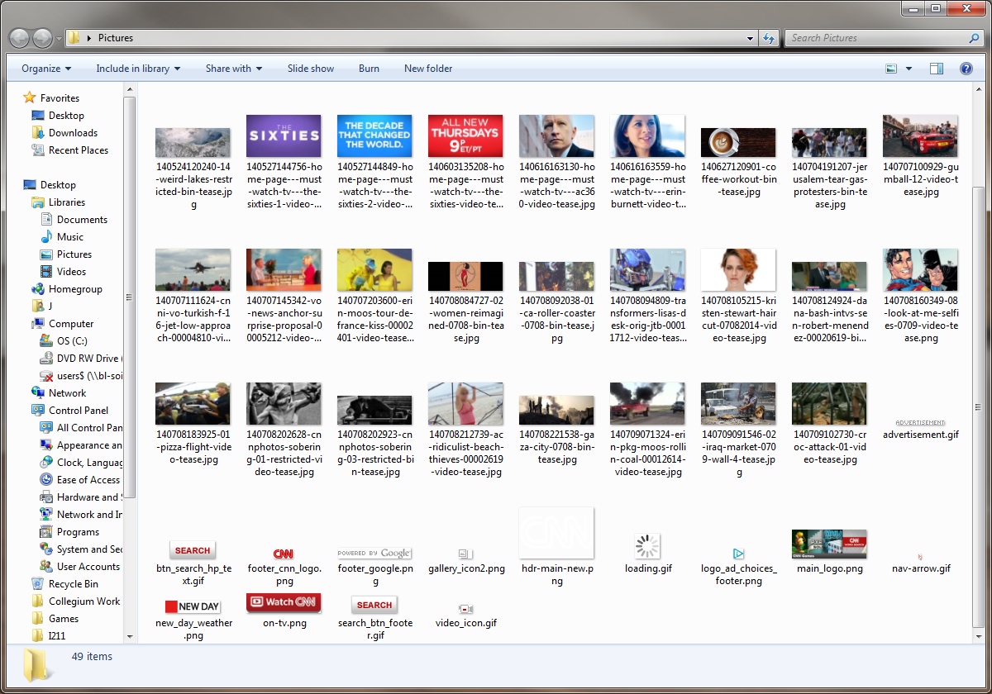
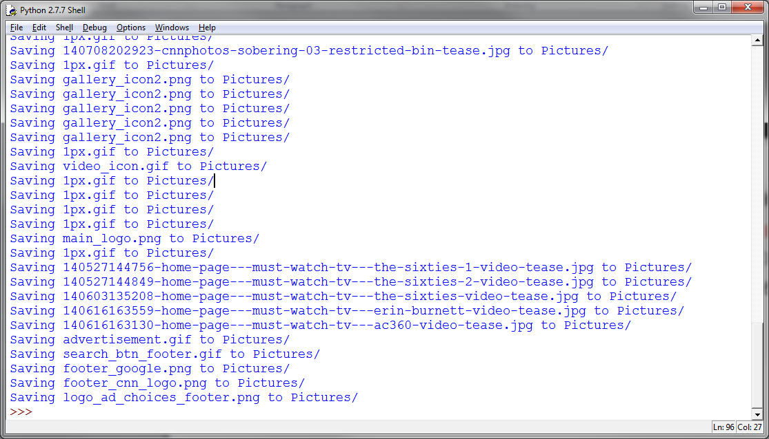
CNN Images (Group Work)
Create a folder on your Desktop called “Pictures”.
Write a function called image_list that returns a list of all the URLs to images on a web page (HINT: images use the img tag, with an src attribute)
Download all of the images from http://www.cnn.com to your Pictures folder. Make sure they have their original names!

Slide 17
CNN Images (Solution)
import urllib, os
def image_list(page):
web_page = urllib.urlopen(page)
lines = web_page.readlines()
web_page.close()
images = []
for line in lines:
parts = line.decode("utf-8").replace(">", "<").split("<")
for item in parts:
if "img" in item and "src=" in item:
item = item[item.index("src="):]
image_parts = item.split("\"")
if len(image_parts) > 1:
images.append(image_parts[1])
return images
#main
pictures = image_list("http://www.cnn.com/")
for im in pictures:
print "Saving", os.path.basename(im), "to Pictures/"
urllib.urlretrieve (im, "Pictures/" + os.path.basename(im))

Slide 18
Questions?

